Slide 1
EECS 4088: Ownership in Brightsquid
Quang Hy Le

Slide 2
Motivations
Replicate the “Don’t touch my code” paper to 38 Brightsquid repositories.
Analyse the ownership in 2 different periods, from March 2018 to March 2020 and March 2020 to present.
Answer 5 research questions:
Are higher levels of ownership associated with fewer defects in Brightsquid projects?
Is the result from Brightsquid projects related to the results in the “Don’t touch my code” paper?
Is there a negative effect when a software entity is developed by many with low ownership?
Is the relationship between low ownership and software quality in Brightsquid related to the results in the paper?
Are these effects related to change in ownership?

Slide 3
Ownership metrics
MINOR: number of minor contributors who have made less than 5% commits to a file.
MAJOR: number of major contributors. Or, contributors who have made more than 5% commits to a file.
TOTAL: total number of minor and major contributors
OWNERSHIP: proportion of ownership for the contributor with the highest proportion of ownership

Slide 4
“Classic” metrics
Churn: The number line of codes added and removed by the developers to a file
Size: The number line of code in a file
Complexity: Cannot be determined yet

Slide 5
Collecting Ownership Metrics Data
Retrieves ownership metrics based on the developer’s commit to a file in a repository.
Collects the amount of bugs or failures in the repository by extracting the commits that has the keywords “bug” or “fix” in the commit’s title or commit messages.
Calculates the Spearman correlations between the ownership metrics and number of failures in the project.
Retrieves ownership metrics in each file
Collects the amount of bugs or failures in the repositories
Calculates the Spearman correlations

Slide 6
Collecting “Classic” Metrics
Retrieves churn and size of files in a repository.
Collects the amount of bugs or failures in the repository by extracting the commits that has the keywords “bug” or “fix” in the commit’s title or commit messages.
Calculates the Spearman correlations between the ownership metrics and number of failures in the project.
Retrieves churn and size metrics
Collects the amount of bugs or failures in the repositories
Calculates the Spearman correlations

Slide 7
Collecting Churn Metric
Using GitHub and Git CLI to retrieve the log of the repository.
Separate the log into 2 periods of time.
Calculate the added and removed line of code in each file.
Retrieve the log from the repository
Divide the log into 2 periods of time
Count the churn

Slide 8
Collecting Size Metric
Get the latest commit in the period of time.
For example, in the period from March 2018 to March 2020, we will get the commit that is closer to March 2020 but not later March 2020.
Check out the branch to the commit’s branch.
Go through all the file of the project and count the number line of code.
Get the latest commit
Check out to the commits branch
Calculate the size of the files of the project

Slide 9
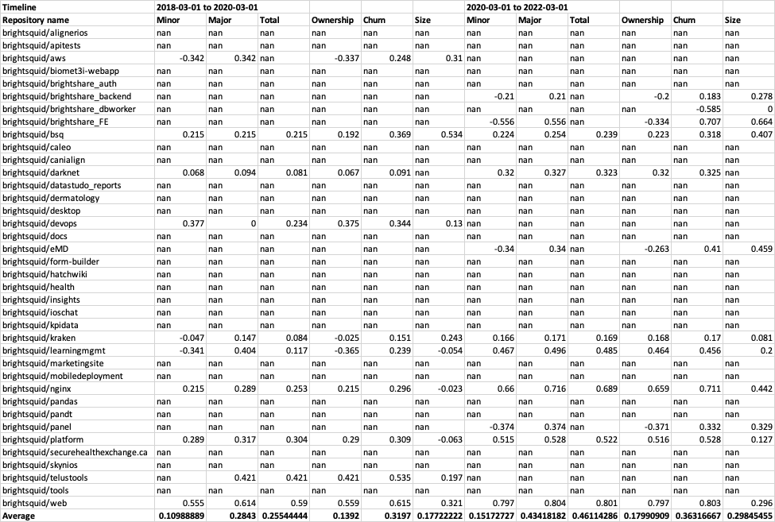
Results

Slide 10
Research Questions
Are higher levels of ownership associated with fewer defects in Brightsquid projects?
No, the relationship between the ownership level and the number of defects is very weak.
Is the result from Brightsquid projects related to the results in the “Don’t touch my code” paper?
No, there is a strong relationship between the ownership of files and the number of defects in the paper.
Is there a negative effect when a software entity is developed by many with low ownership?
No, the relationship between low ownership and software quality is very weak
Is the relationship between low ownership and software quality in Brightsquid related to the results in the paper?
No.
Are these effects related to change in ownership?
The change in ownership increase the relationship between major ownership and number of failures.

